Slide 1
Gender, food security and sustainable agriculture overview
Takudzwa B Tiengane B231789A

Slide 2
Definition of terms
Gender refers to the characteristics of people that are socially constructed. It includes norms, behaviors, and roles associated with being a man, woman, or other gender identity. Depending on the context, gender may include sex-based social structures (i.e. gender roles) and gender expression.

Slide 3
Definition of terms
Food security exists when all people, at all times, have physical, social, and economic access to sufficient, safe, and nutritious food that meets their dietary needs and preferences for an active and healthy life. Achieving food security requires sustainable agricultural practices that ensure stable food production, equitable distribution, and access to nutritious food.

Slide 4
Definition of terms
Sustainable agriculture focuses on enhancing productivity while minimizing negative environmental impacts. It involves practices such as conservation agriculture, agroforestry, organic farming, and crop diversification. Sustainable agriculture also emphasizes the efficient use of natural resources, reducing food waste, and promoting biodiversity.

Slide 5
Gender, food security, and sustainable agriculture are interconnected issues that play a significant role in shaping the overall well-being and development of societies

Slide 6
Gender and Agriculture:
Gender roles and inequalities have a profound impact on agriculture.
Women make up a substantial portion of the agricultural workforce in many developing countries, contributing to food production, processing, and marketing.
However, they often face limited access to resources such as land, credit, technology, and extension services.
Gender-based discrimination and unequal access to resources hinder women's productivity and their ability to fully participate in agricultural activities.

Slide 7
Promoting gender equality in agriculture is crucial for sustainable development.
Empowering women farmers by providing equal access to resources, agricultural training, and credit can enhance their productivity and contribute to food security.
It can also help reduce rural poverty, improve nutrition, and foster economic growth.

Slide 8
Importance of Gender in Food Security
Gender roles and norms significantly influence access to and control over food resources, distribution patterns, and decision-making processes related to food production and consumption.
Gender disparities in food security can perpetuate cycles of poverty and social inequality.
By understanding and addressing the specific challenges faced by women and men in relation to food security, effective interventions can be designed to ensure equitable access to nutritious and sufficient food for all individuals, regardless of their gender.

Slide 9
Intersections and Challenges:
Gender inequalities in agriculture can undermine food security and sustainable agricultural practices.
Limited access to resources and decision-making power for women can result in reduced agricultural productivity.
Gender disparities also affect women's ability to adopt sustainable farming methods and technologies.

Slide 10
Cont….
Addressing these challenges requires integrating gender perspectives into agricultural policies and programs.
This includes promoting women's land rights, improving access to credit and extension services, strengthening women's participation in decision-making processes, and providing training and capacity-building opportunities.

Slide 11
Cont…
Furthermore, sustainable agriculture practices can contribute to gender equality and food security.
sustainable farming methods can enhance soil fertility, improve crop yields, and reduce the vulnerability of farmers to climate change.
These practices can benefit both men and women farmers, ensuring a more equitable distribution of resources and promoting long-term food security.

Slide 12
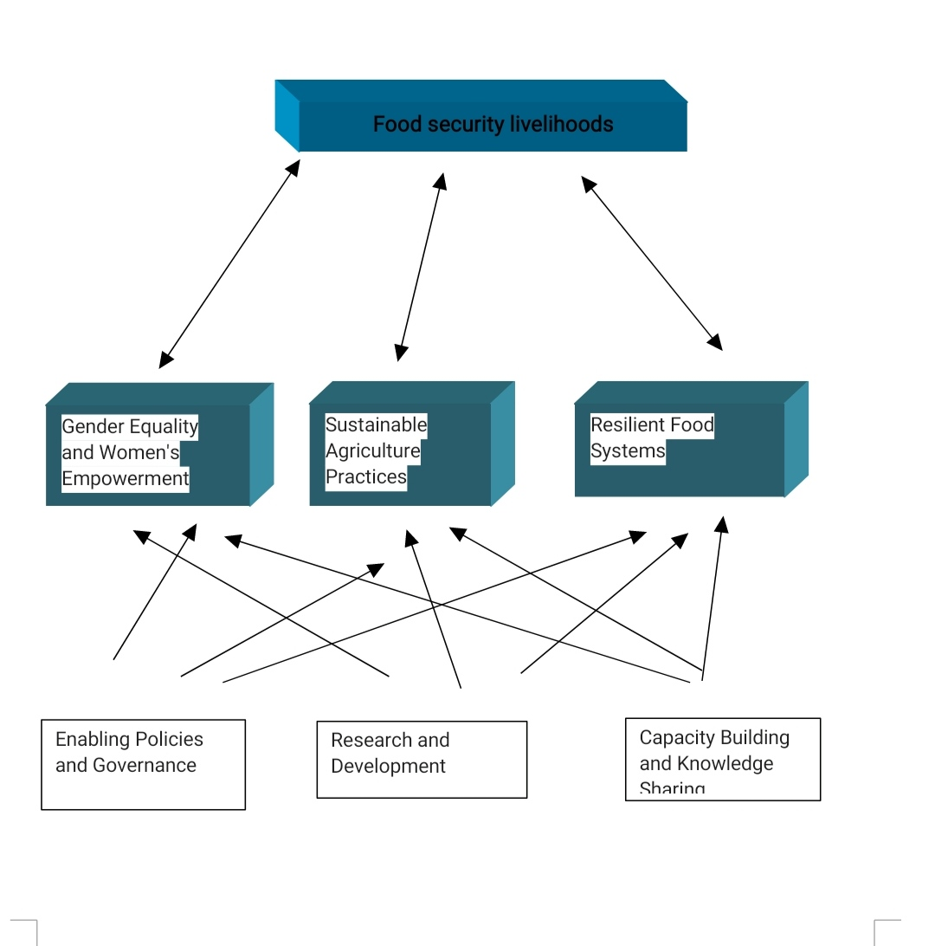
Gender, food security and sustainable agriculture framework

Slide 13
Goal
Food Secure Livelihoods: This represents the ultimate goal, where individuals and communities have consistent access to sufficient, safe, and nutritious food that meets their dietary needs and food preferences for an active and healthy life.

Slide 14
Supporting Pillars:
Gender Equality and Women's Empowerment: Women play crucial roles in food production, processing, and preparation. Empowering them through access to land, resources, education, and decision-making power is essential for achieving food security.
Sustainable Agriculture Practices: These practices aim to produce food while conserving the environment and natural resources for future generations. Examples include crop diversification, integrated pest management, soil conservation techniques, and agroforestry.
Resilient Food Systems: This refers to the ability of food systems to withstand and adapt to shocks and stresses, such as climate change, natural disasters, and economic crises. Building resilience involves diversifying food production systems, strengthening local food markets, and investing in social safety nets.

Slide 15
Enabling Factors:
Enabling Policies and Governance: Governments can play a crucial role in promoting gender equality, sustainable agriculture, and resilient food systems through appropriate policies, investments, and regulations.
Research and Development: Continuous research and development are essential for identifying and promoting effective interventions in gender, food security, and sustainable agriculture.
Capacity Building and Knowledge Sharing: Empowering individuals and communities through training, education, and knowledge sharing is key to adopting sustainable practices and achieving food security.

Slide 16
Conclusion
gender, food security, and sustainable agriculture are closely intertwined.
Promoting gender equality in agriculture and adopting sustainable farming practices are essential for achieving food security, reducing poverty, and building resilient agricultural systems that can sustainably meet the needs of present and future generations.

Slide 17
REFERENCES
Gender and health - World Health Organization (WHO). https://www.who.int/health-topics/gender.
https://www.undp.org/publications/dfs-women-agents-change-greening-agriculture-and-reducing-gender-inequality
https://www.fao.org/policy-support/tools-and-publications/resources-details/en/c/1473688/
https://www.qub.ac.uk/schools/SchoolofBiologicalSciences/Events/EventsArchive/CelebratingLocalWomeninLeadership.html

